Slide 1


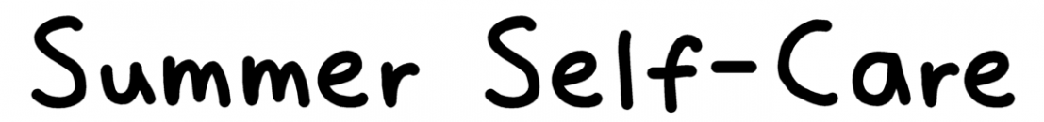
To understand what self-care means
To explore ways to take care of your mental health and wellbeing during the summer holidays

Slide 2
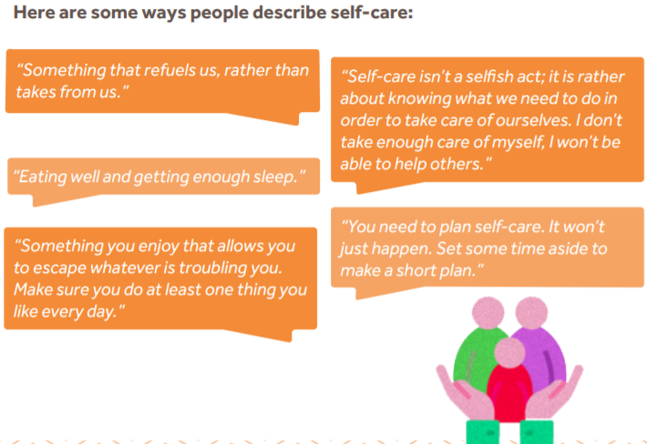
What is self-care?
Self-care is all about what you can do to help yourself feel better or to keep yourself feeling good.
It’s a way that we can look after our own mental health and wellbeing.
Everyone’s approach to self-care will look different.
The main thing is to find things you enjoy. e.g. Playing football, listening to music, reading. Sometimes having a long bath can be relaxing. Whatever works for you.

Slide 3
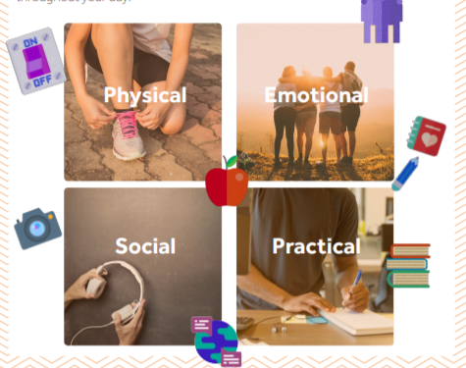
By breaking down your self-care approaches into different categories (physical, emotional, social and practical) you will be able to monitor and positively influence your wellbeing throughout your day.

Slide 4
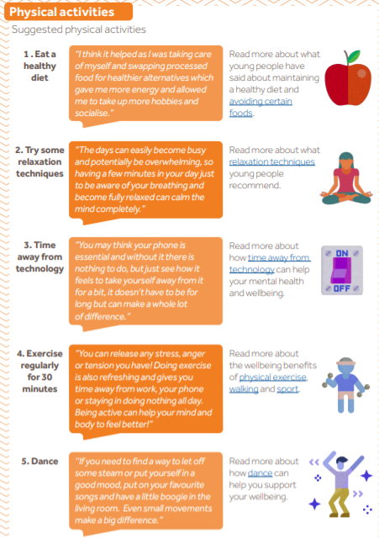
Self-care examples

Slide 5
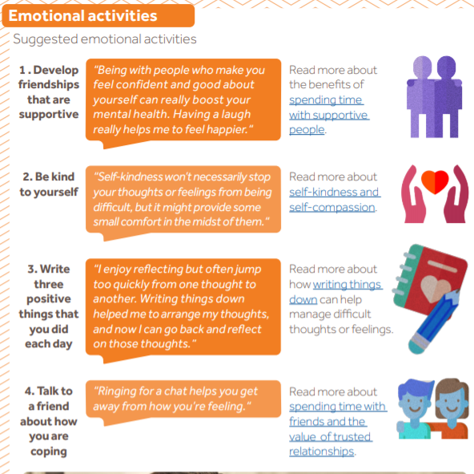

Slide 6
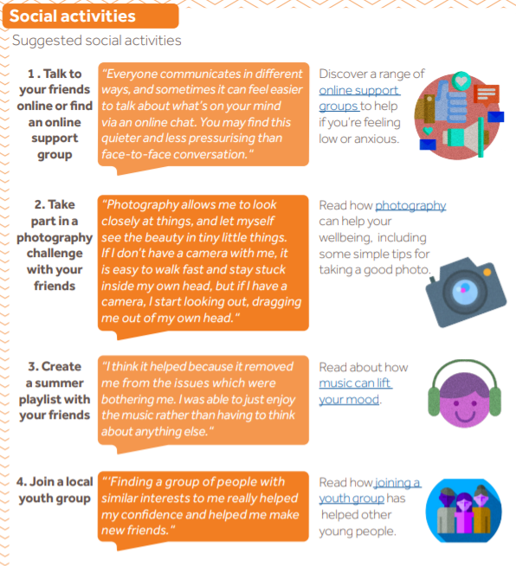

Slide 7
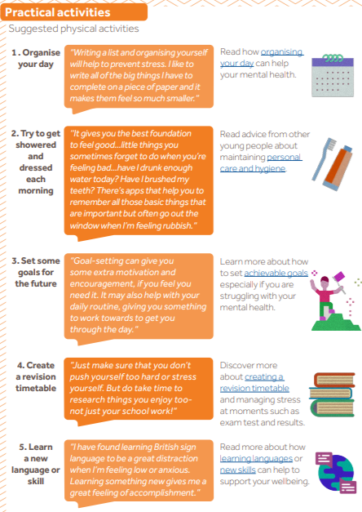

Slide 8
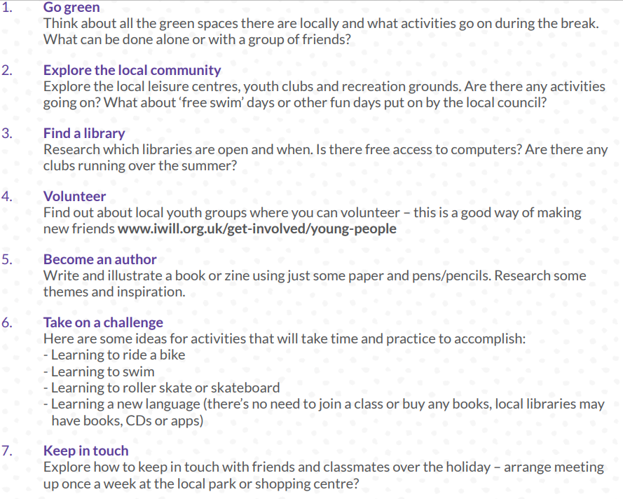
Other examples to keep you busy

Slide 9
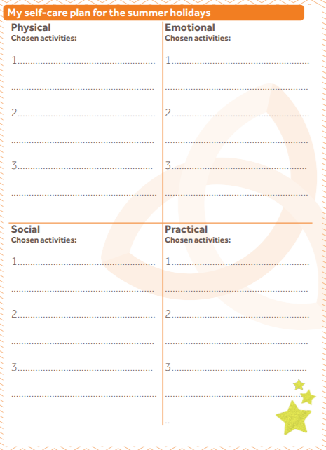
What is your self-care plan for the summer?
Discuss or have a go at completing one
Visit the virtual wellbeing board on the school’s student wellbeing area to give you more ideas and links to more information:
https://www.arthurterry.bham.sch.uk/well-being/
https://padlet.com/hvb123/xwhbdi9sy8hp110f

Slide 10
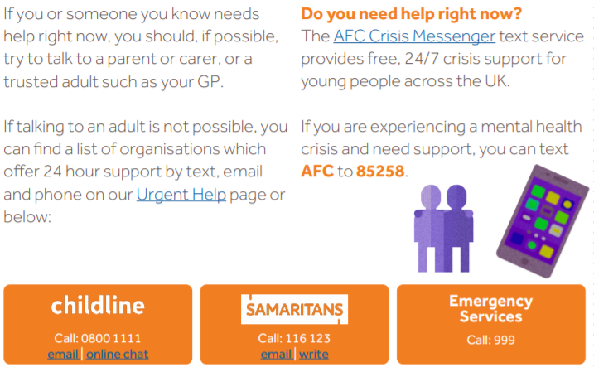
Where can you find support over the summer?
The student wellbeing area has all the information and contact details for support over the summer holidays: https://www.arthurterry.bham.sch.uk/well-being/
Websites & apps:
Forward Thinking -https://www.forwardthinkingbirmingham.org.uk/
Young minds - https://youngminds.org.uk/
Mind - https://www.mind.org.uk/
Childline - https://www.childline.org.uk/
The Mix - https://www.themix.org.uk/
Apps: Calm, Headspace, Ten percent happier
Notes:
Highlight where students can get support

Slide 11
Optional Resources

