Slide 1

Give back to yourself
There is strong connection between your physical wellbeing and your mental wellbeing
Whilst we are in lockdown, there are several ways to help you maintain both

Slide 2


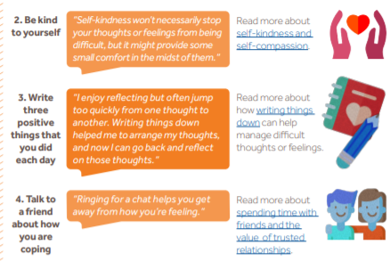
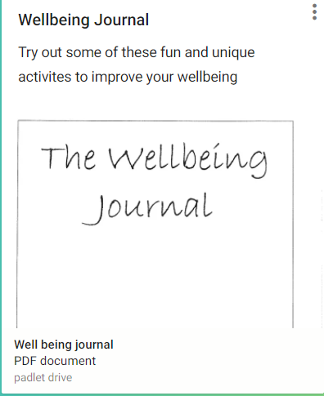
Give back to your mental health
Mindfulness - https://www.mentalhealth.org.uk/podcasts-and-videos/mindfulness-10-minute-practice-exercise
Top tips
Create yourself a routine, structure your day, so you can work efficiently, don’t overload yourself with too much
Make sure you give yourself a break and a lunch time to unwind and refresh your mind
Try and get some fresh air if you can
Click here
Click here
Make sure you stick to lockdown rules though!
Click here
Wellbeing journal – download on the student virtual wellbeing board https://www.arthurterry.bham.sch.uk/well-being/

Slide 3
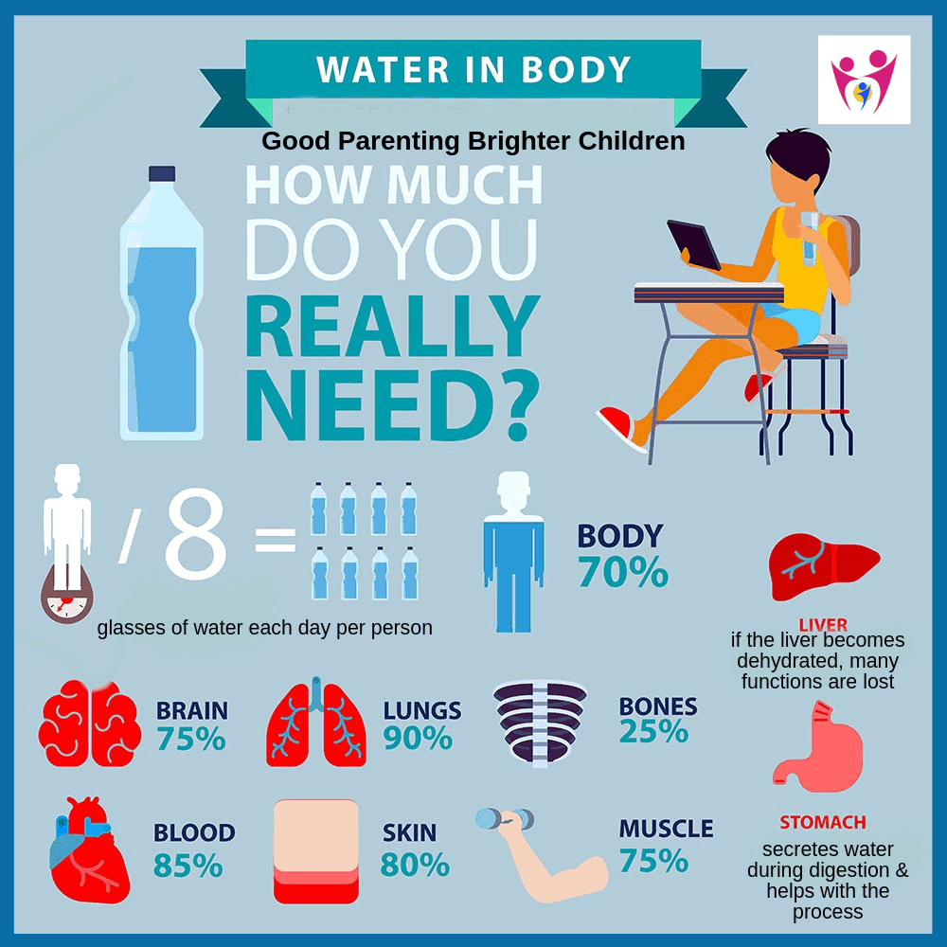
Did you know water can help you regulate stress and worry?
Give back to your physical health
Top tips
Try not to sit in the same place all day, try to move around and take a stretch in your breaks
Maintain healthy eating and ensure you’re still drinking plenty of water
If possible go on a walk or just go outside to gain some fresh air .
Water is probably one of the most essential components for our bodies and brains to operate at 100%.
Many of us fail to drink enough water in a day. You are not alone in that.
Apps have been designed for you to track how much water you have drunk. There are even water bottles with an alarm to remind you to drink!
It’s simple: you increase your brain’s temperature and get rid of toxins and dead cells. It also helps balance all your brain chemicals, like a “mental restart”
But, stay hydrated. Take small sips throughout the day. This way, your cells will stay active and find a good balance. This balance will also help regulate your stress and worry!

Slide 4
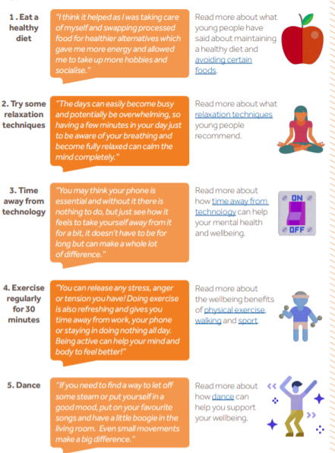
Give back to your physical health
Click here
Click here
Click here
Click here

Slide 5
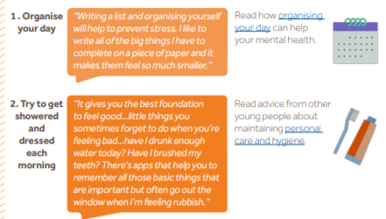

Organisation/ School Work
Top tips
Allow yourself enough time to wake up in the morning and get ready for the day ahead
Collect all you work, exercise books or any necessary work that you know you may need within your lessons
Perhaps create a checklist to tell you what tasks you have left to do
Keep your workspace tidy, create yourself a clean working environment

Slide 6
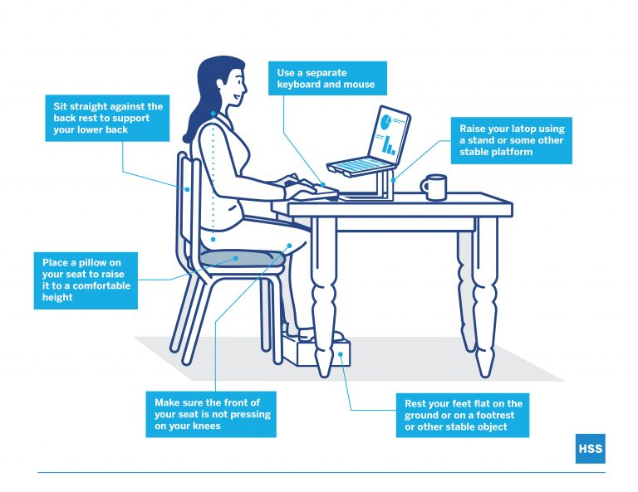
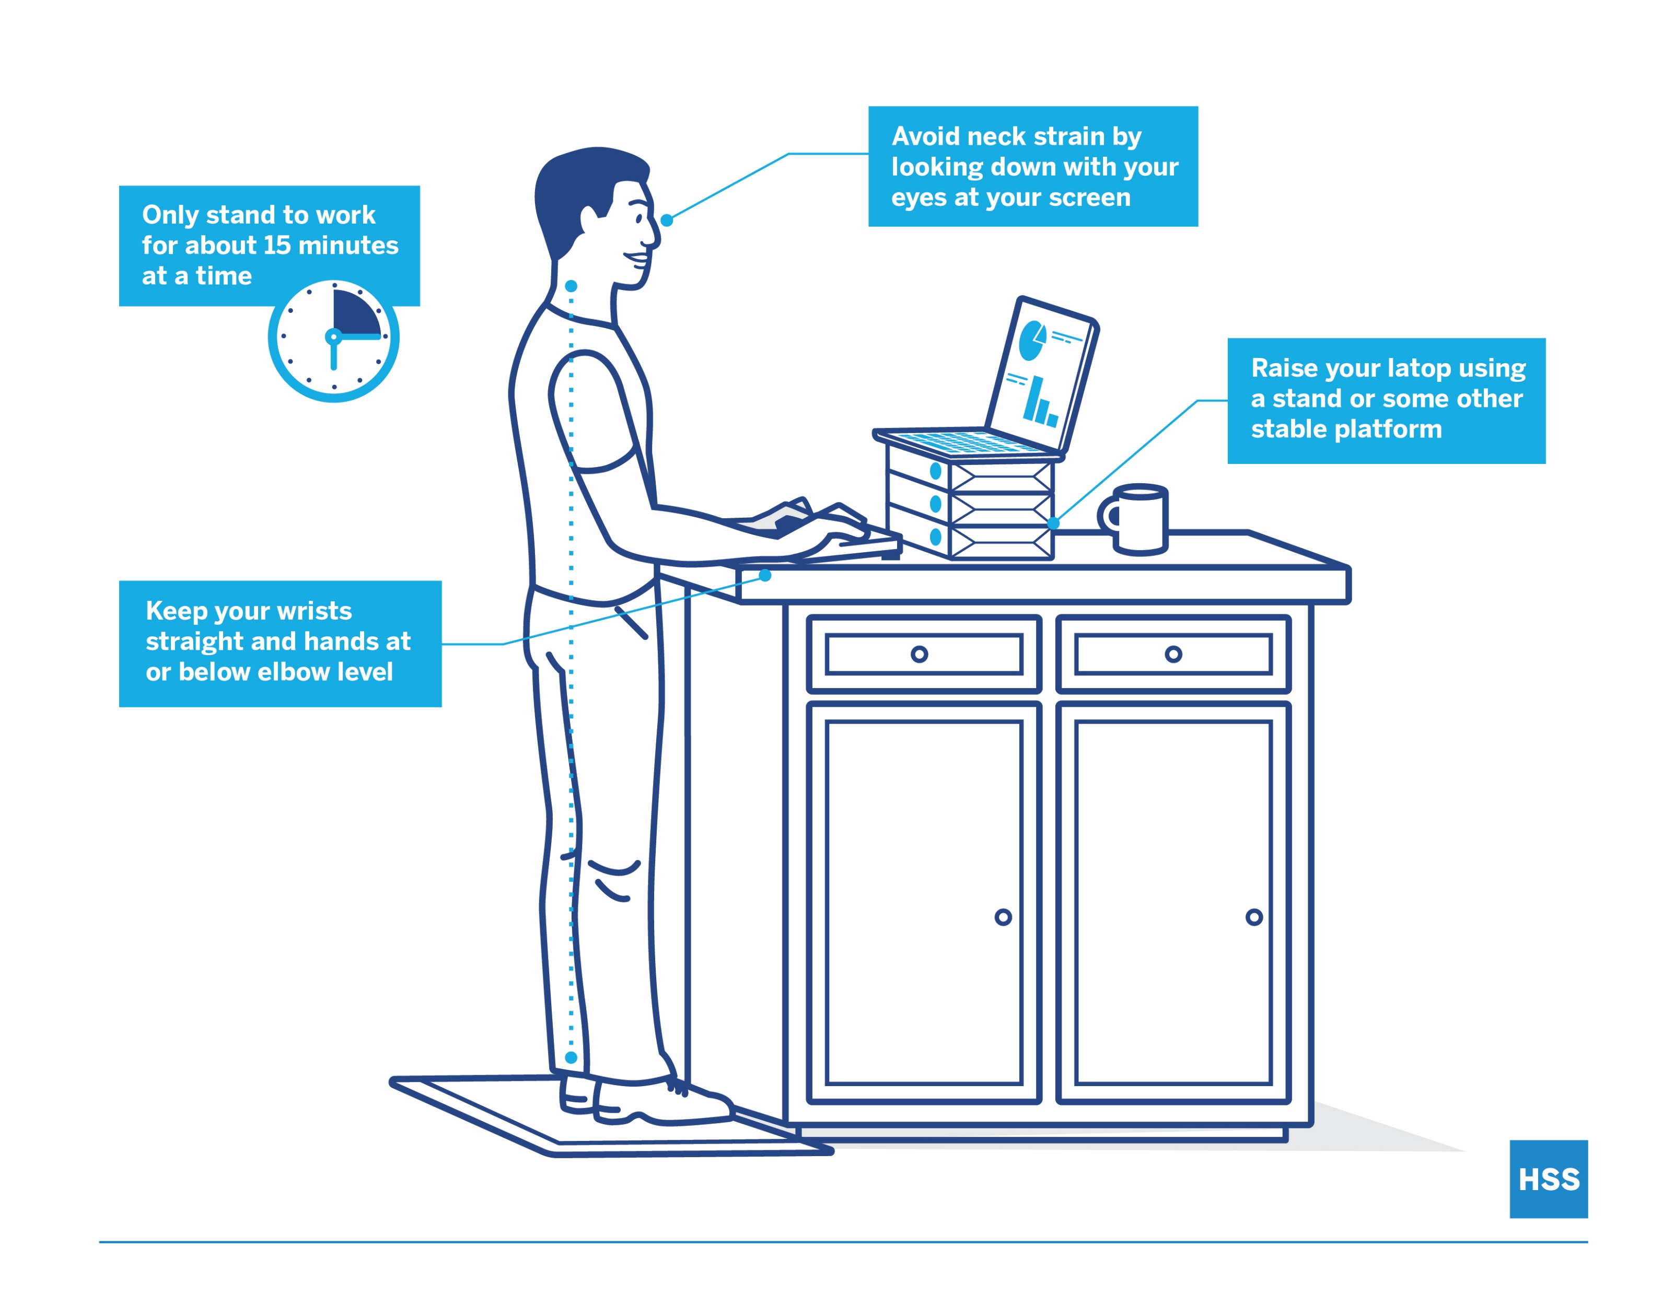
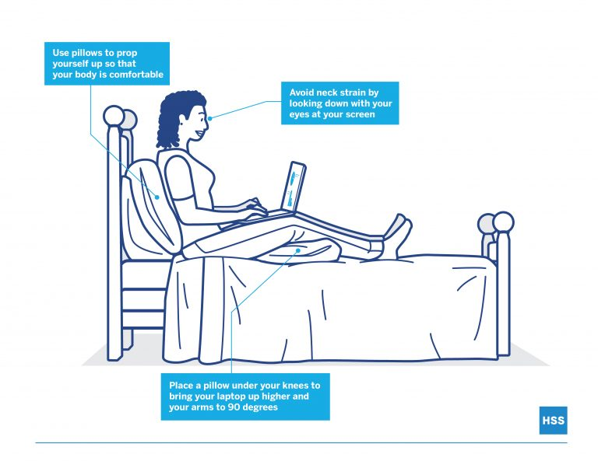
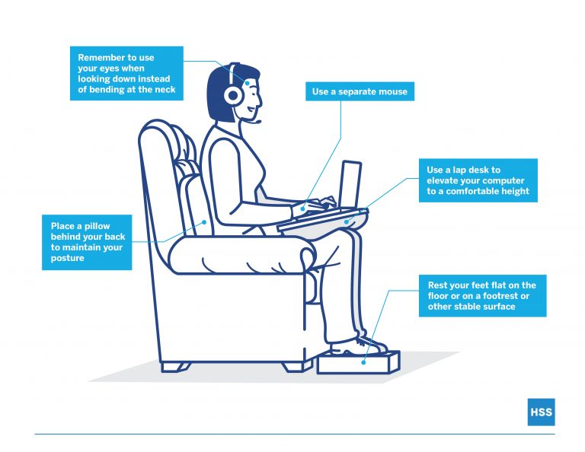
Better posture during your lessons

Slide 7
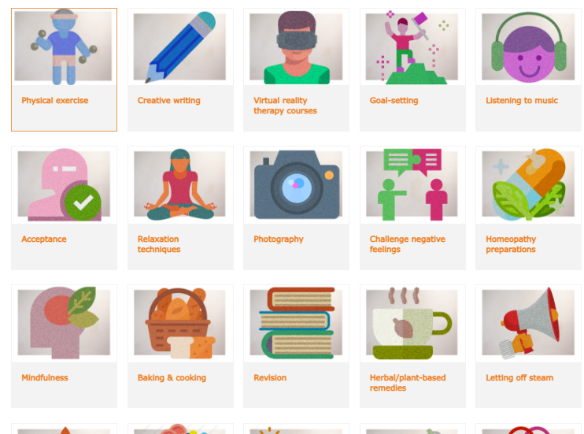
90 self-care strategies
https://www.annafreud.org/selfcare/

Slide 8
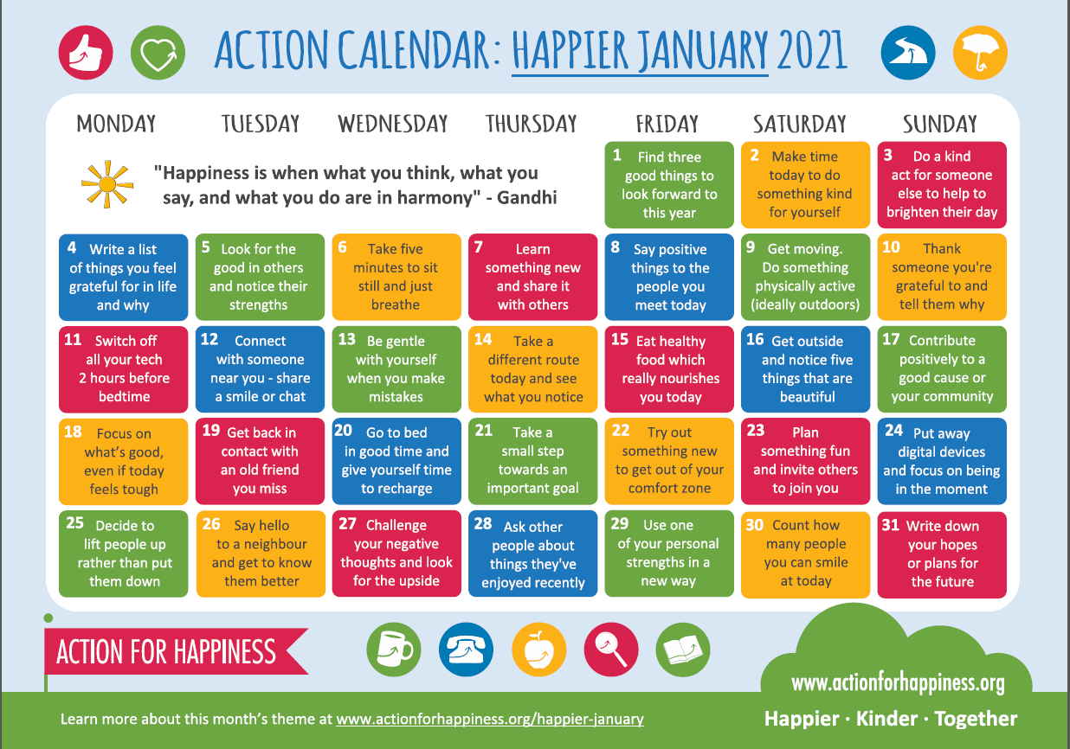
Add a little more happiness this month by following this ‘Happier January’ daily calendar
Download on the student virtual wellbeing board https://www.arthurterry.bham.sch.uk/well-being/

Slide 9



Useful Organisations
If you need support you can contact your tutor, teacher or Student Support services
https://www.arthurterry.bham.sch.uk/well-being/wellbeing/student-support-services-sss/
https://www.nhs.uk/oneyou/every-mind-matters/anxiety/
Pause is here for you, if you are under 25 and have a Birmingham GP. We offer a non-judgemental listening ear, self-help strategies plus skills for managing difficult situations and feelings. We are open 10am-6pm, seven days a week.
Drop us an email on askbeam@childrenssociety.org.uk or call 0207 8414470 and we will arrange for one of our friendly team to call you back.
For more info check out https://www.forwardthinkingbirmingham.org.uk/
https://www.myh.org.uk/helpline

Slide 10
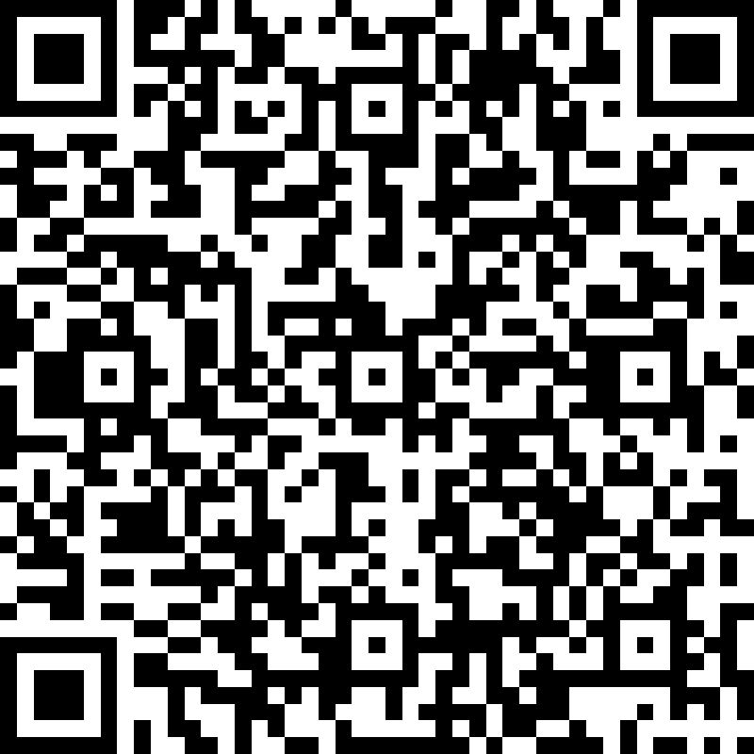
Quiz time
https://forms.office.com/Pages/ResponsePage.aspx?id=onNUZMViq0uKbYN8DZZYfJT0AofSYllLgAOO-CaMcI5URFBFWThPTDRZNktOSjZRNjhOQkxZSlQ1Ny4u

