Slide 1



Well-being Committee needs you!
We are looking for proactive, passionate students to lead the way in creating a happier environment in our school, for everyone!!
Do you care about wellbeing and mental health?
Do you want to make a positive change?
Do you want to make our school a happier and more encouraging place for everyone?
Do you want to help others in school to live more healthily?
Want to get involved?
Speak to Mrs Barnwell – hbarnwell@arthurterry.bham.sch.uk or message on Teams

Slide 2

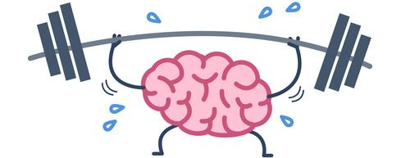
Building resilience by taking control
Learning:
What is resilience?
What are your current worries/anxieties?
What can you do to take control of these worries and improve your resilience?

Slide 3


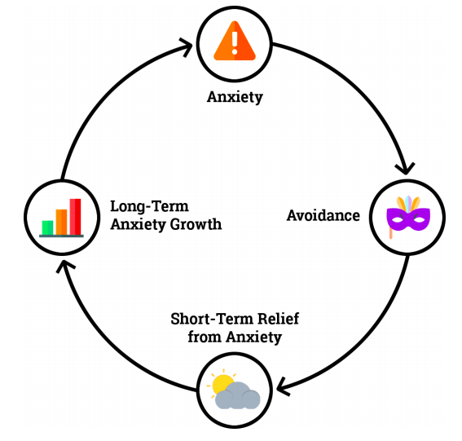
Resilience - the capacity to recover quickly from difficulties; toughness.
How resilient are you?...well, you’ve come to school and/or been isolating and you’ve continued to learn, despite the uncertainty of each day.
THAT IS SOME AWESOME RESILIENCE!!!
BUT…What’s on your mind? What might be making you feel anxious/worried right now?
The Anxiety Cycle
Avoiding things that make us anxious only makes it worse.
Notes:
Class discussion

Slide 4
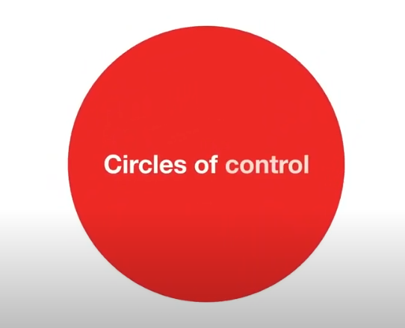
Don’t ignore it – take control!
Whilst watching this 1 minute video, have a go at the task – you will need a pen and some paper (or use whiteboards).
Take control - Now, with the person next to you, help each other find ways to overcome some of your worries and take control.
What have you learnt? Will you do anything differently?
https://www.youtube.com/watch?v=1mw6M-0_Q7I

Slide 5

Year 11, 12 and 13
Don’t ignore it!
Take control!

