Slide 1
Taking notice of the positive within and around you to build resilience

Slide 2
Putting on the rose-tinted glasses?

Slide 3
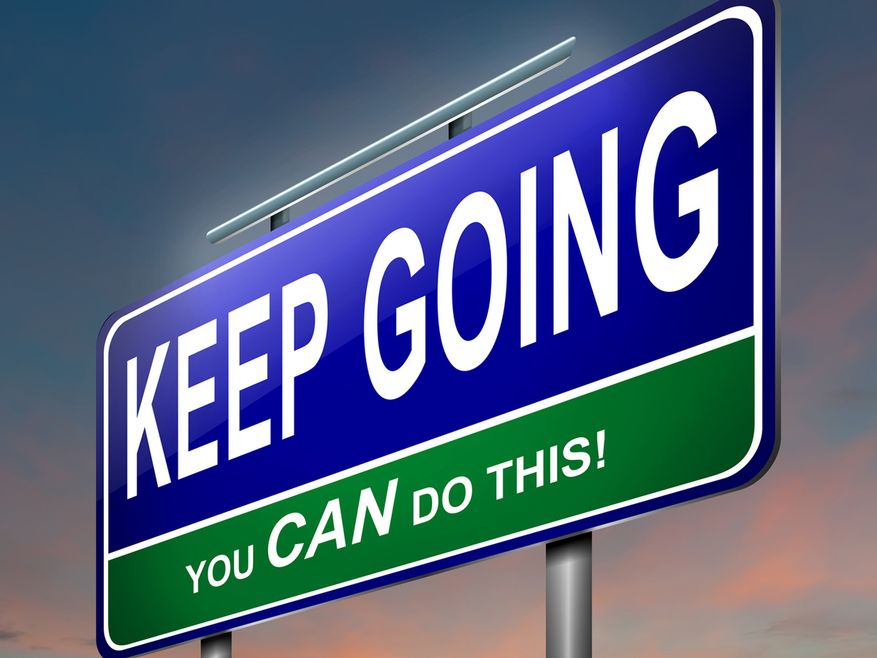
Resilience refers to our ability to cope with problems/challenges.
Resilience is created internally (how we think/see the world) but also externally (how we support and help others).
How would being positive help you to feel more able to cope with the challenges of life?
How can working together help to build everyone’s resilience?
Doing your best in lessons so everyone can learn together
Helping around the home
Listening to each other

Slide 4
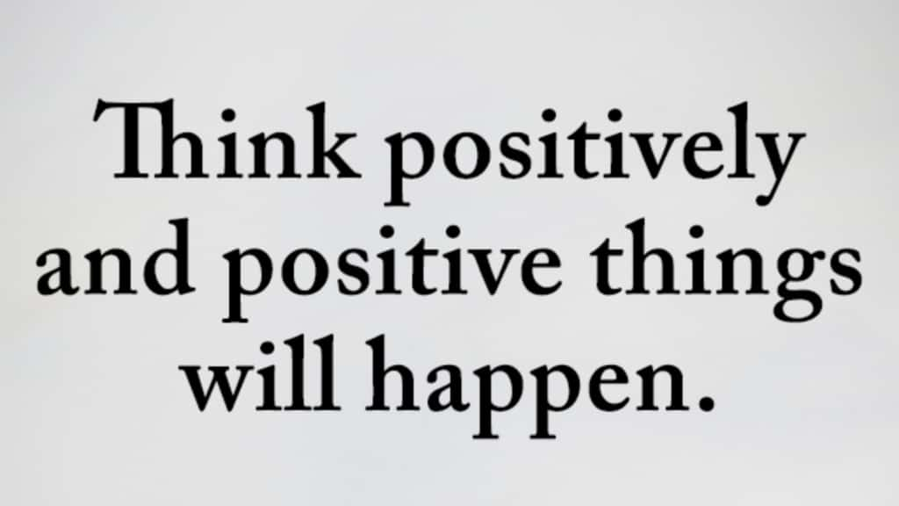
Take a moment now to think about one challenge you may have and what you can positively do to help yourself overcome the challenge.

Slide 5
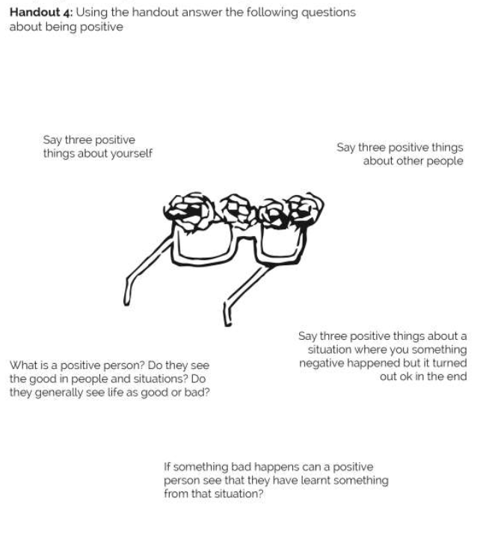

Slide 6
One way to Take Notice is Mindfulness
Thank you for taking part in the Mindfulness Minutes week before Easter.
Please take 2 minutes at home to complete the Mindfulness reflection survey assigned on G4S

