Slide 1

Students: Please take one minute at home to complete the survey to reflect on wellbeing in school this year.
This link is assigned to you on G4S:
https://forms.office.com/Pages/ResponsePage.aspx?id=onNUZMViq0uKbYN8DZZYfOEncZM8HFdIog1NJDUgEq1UN09ROVY0SzVYVjhWU1o5Sks0Wjg2MzVINy4u

Slide 2


Recognising the importance of being unique
Identifying your own and each others positive ‘star’ qualities

Slide 3
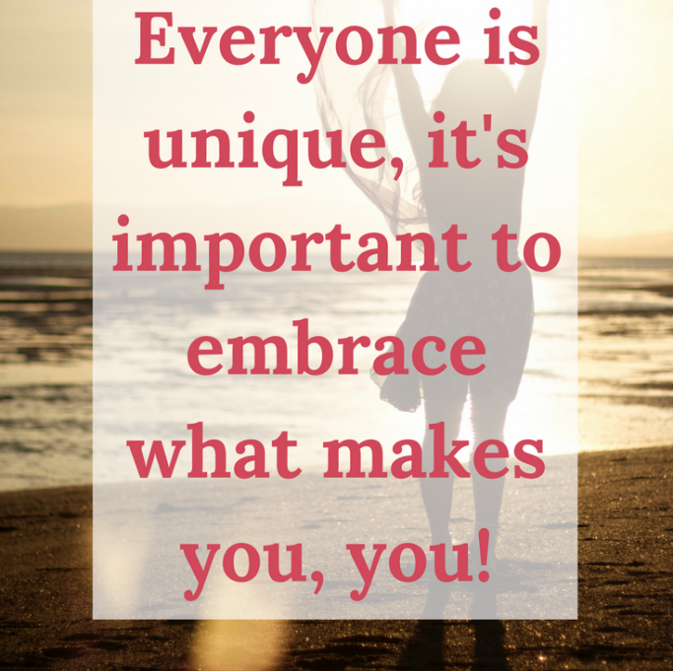
The importance of being unique?
Every human being that has ever lived, or ever will live, is unique. You are truly one of a kind. We all know that we, as humans, share the usual bits and pieces that most of us have in common.
It is the combination of everything that you have learned and the various things that you have done that make you truly different from everyone else on this planet.
Others may share some of your talents and abilities, but there is no one who is identical to you.

Slide 4




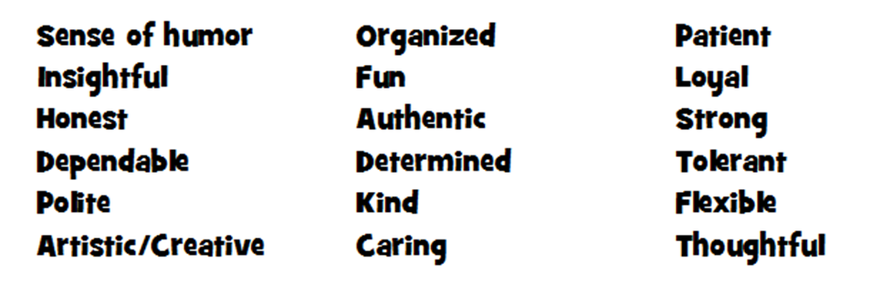

How does identifying your‘star’qualities help with your wellbeing?
Recognising your ‘star’ qualities
How we think about ourselves affects how we feel about ourselves and how we interact with others and the world around us.
A positive self-image can boost our physical, mental, social, emotional, and spiritual well-being.

Slide 5

1. Write your FIRST name ONLY in the middle of your star
2. Take a moment of reflection and think of some of the strengths and qualities that you like in yourself.
4. Ask other people in your class to write positive qualities about you in each of the points of the star
3. Write 2 of these qualities above and below your name

Slide 6


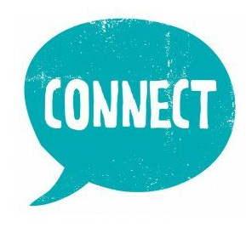
How does it feel when someone says something positive about you?
Describe how these ‘positives’ stay with you or others.
Do these make you/others feel more resilient?

