Slide 1
A 10% discount will be available in-store if students bring proof of their DofE membership.
In Erdington
You can get almost everything
from here !!!
It’s on New Street in Birmingham – YOU GET 10% DISCOUNT WITH YOUR REWARD CARD)
In Tamworth and Birmingham
In Wednesbury
Some recommended brands
(search the internet!!!)
GOOGLE: dofe kit list

Slide 2
Hiring Kit
We can lend you these items for £10 per item and a returnable deposit of £20 per item:
Tent
Stove
Sleeping bag
Kipmat
Rucksack
It is advisable that you buy your own equipment really
If you want to hire anything, you need to complete a ‘Kit Hire’ form on the DofE webpage via the main school website before FRIDAY 15TH APRIL (with payment IN CASH ONLY to Miss Wilson in C3.8) so we know how much we need to organise for you.
You will then be emailed with a collection time and return time.
http://www.arthurterry.bham.sch.uk/dofe/kit-hire/

Slide 3
Kit List
GROUP:
Group Kit | Carried by…. | Packed
Tent inner
Tent outer
Tent poles/pegs
Stove
Pots and pans
Fuel
Washing-up liquid and scourer
String
Personal kit (other) | Packed
Rucksack and liner (55-65 litre) | Wear !
Sleeping mat
Sleeping bag
Water bottle/Platypus
Knife/fork/spoon
Mug and plate/bowl
Matches (in sealed bag)
Tea towel
Emergency contact procedure
Maps (and map case)
Compass, route cards
Head torch/Torch and spare batteries
Emergency whistle
Alarm clock/watch
Notebook and pencils
Money
Camera
Binliners (for keeping things dry and for rubbish)
NAME:
Personal kit (toiletries/medical) | Packed
Personal basic first aid kit
Blister plasters
Sun cream/mosquito repellent
Toothbrush and paste
Deodorant
Personal toiletries
Small towel
Toilet paper
Water purification tablets (if advised)
Personal kit (Clothing) | Packed
Walking boots | Wear !
Walking socks (1 per day)
T-shirts/base layers (1 per day)
Fleece top/jumper
Walking trousers (not jeans)
Underwear/Bra
Nightwear
Comfy footwear(for campsite)
Shorts, Sunhat (warm weather)
Woolly hat/scarf/gloves (Cold weather)
Waterproof coat/top and trousers
The only kit that can be attached to the outside of your rucksack is a sleeping mat, which must be in a waterproof bag

Slide 4
Advice for buying kit
Boots – sturdy and waterproof with ankle support (trainers are OK for Bronze). Brush off the mud when dry after you get home. Don’t spend a fortune! Comfort is most important.
Walking socks – keep your feet as dry as you can to avoid blisters.
Tents – the cosier the better, make sure you all know how to put it up (and quickly). 3-man tents usually only sleep 2 comfortably (buy one that is for one more person than you need)
Sleeping bags – stuff them in, don’t roll them – wrap in a black bin bag to stay dry. 2-3 season and mummy-shaped is best!
Kipmat – the only thing that can be attached to the outside of your rucksack (in a sealed binbag too!)
Clothes – Use a layering system to trap air (which will keep you warmer)
Inner layer (T-shirt/synthetic base layer)
Middle layer (fleece/jumper)
Outer layer (waterproof and windproof jacket)
Legs – NO JEANS or thick cotton tracksuit bottoms!! (why?) Synthetic tracksuit bottoms are best or walking trousers (maybe with long-johns underneath?). You must have waterproof over-trousers too.
A hat is essential (to protect you from the sun!)
Ideally, you should have a map case to contain your map, route card and compass.
Rucksack – 55 to 65 litres with lots of outside pockets for easy access to water, food, waterproofs, notepads, pencils, camera etc.
A Head torch is a good investment too.

Slide 5
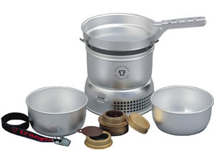
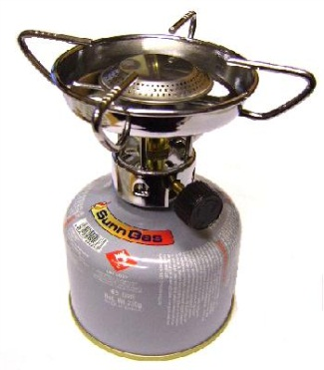
Cooking Safely
Gas canisters for stoves must be re-sealable (if you buy your own gas stove).
If unsure, please email us:
dofe@arthurterry.bham.sch.uk
Trangia
Gas Stoves (you have to buy your own gas!!)

Slide 6
Rucksack Packing
Suggestions
Waterproofs
Notepad, pencils
Camera?
Wearing it:
The hip belt should take most of the weight and should be at the top of the hip bone.
Shoulder straps should be tight-ish, ensuring the rucksack is high and against your back.
Be ‘as one’ with your rucksack
Key Points:
Red sections are easy to access.
Heavy items should be near the top of the main section and close to your back.
Stuff clothes (in bags around bigger items in the main section)
Use the bathroom scales to see how heavy it is – NO MORE THAN ¼ OF YOUR MASS !!
Keep sharps away from the edge of compartments.
Search ‘How to pack a rucksack’ on Google Videos if you want 10 minutes of even more of this!
Students should pack their rucksack rather than parents so they know what is where!
The only thing that should be outside of your bag is your kipmat.
Stove, pans, mug
Tent
Torch, emergency rations, first aid kit
Water, Trail food, Lunch
Clothes (separate bags)
Food to cook (non-crushable), cutlery
Sleeping bag (sealed)
Kipmat (sealed and securely strapped to the outside)

Slide 7
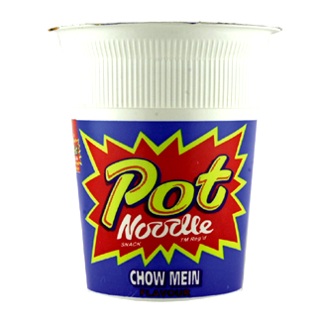
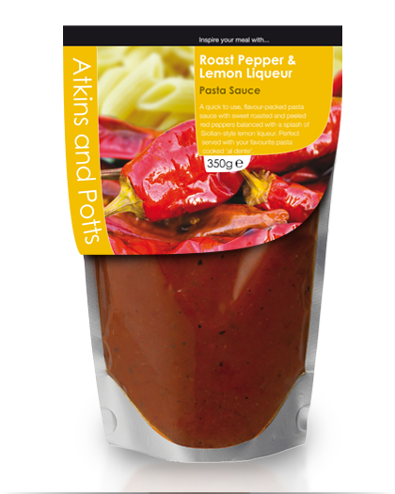
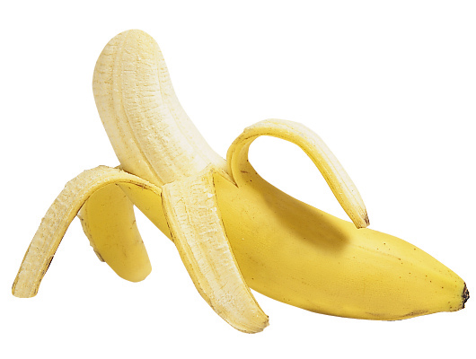
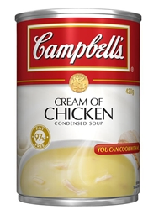
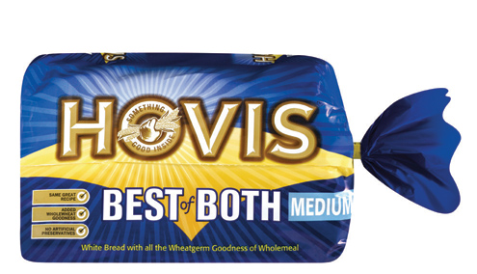
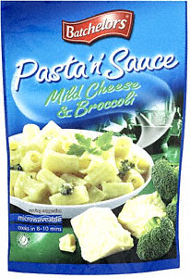
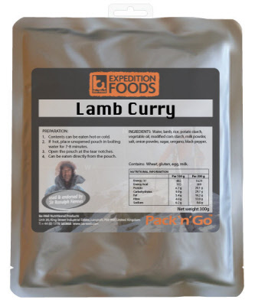
Food choices YES or NO ?
They have NO real nutritional value – a snack not a substantial meal. Supernoodles are just as bad
Good with dried pasta but not in a jar, packets are best
Quick and easy as part cooked
These don’t travel well unless you have a banana case !
Avoid tins if you can, but maybe one for breakfast is ok
OK for 1st day sarnies but easily squashed – pitta bread is better
Ideal for filling pitta breads
Better than pot noodle but you really need to add meat, bread or something else too
The same as bread!
Ideal, easy to cook, no mess and nutritious.. But expensive !!

Slide 8
“Food, Glorious Food”
You must eat regularly for energy and warmth.
What you actually eat is down to personal preference but a sensible diet should be followed as much as possible.
Ideally your choice of food should:
Have a high energy content
A mixture of carbs, protein and fat
Be light and easy to carry (eg packets instead of tins/jars)
Quick and easy to prepare
Tins should have a ring pull to save bringing a tin opener
It is sensible to prepare shared meals (if you can agree) – takes less time, less washing-up and the other group members could be doing other useful things eg. Pitching your tent!
Wayfarer Meals
Expensive (£4.50) but varied and easy to cook.
Look on Amazon !

Slide 9
Menu Ideas (in no particular order)
Breakfast | Lunch | Dinner | Trail Food
Museli/porridge /weetabix with sugar, dried milk and hot water (and dried fruit/chocolate chips). Tea/coffee/ hot chocolate sachet | Filled Baguette, crisps (day 1 only) Carton of fruit juice Flapjacks/ Cake bars | Pasta and sauce with ham and squeezy cheese/cocktail sausages Fruit cocktail in plastic container Coffee/tea/hot choc, sugar, dried milk | Dried fruit & nuts (allergy?) Cereal bars Chocolate bars Flapjacks Pepperami
Foil-packed potato, bacon and onion mix Beans & sausages in a tin | Pitta bread, sandwich paste/ cheese spread, Apple Carton of Ribena | Boil in bag curry, uncle bens part-cooked rice (no need to cook, just add to curry) Wayfarer Treacle Pudding
All-day breakfast in a tin, pitta bread/ fried bread (needs oil) | Bread rolls and corned beef Sausage roll Carton of fruit smoothie | Frozen steak and sausgaes, dried herbs, cous cous. Instant custard
Pancakes and jam/choc spread |  | Tinned mackerel in tomato sauce, Smash/Rissoto
“A hiking friend of mine takes a plastic jar of peanut butter, scoops out about half. To remainder, add honey, chopped dried apricots, chocolate chips, raisins. Mix it all up. Then eat a tsp or two on regular basis on the trail”.
Emergency Rations: Mars bars, glucose tablets, Bottle of cola, Pitta breads, chocolate spread, dried fruit, raw jelly cubes, Kendal mint cake etc. (THESE MUST BE KEPT SEPARATELY AND WILL BE CHECKED AT THE END OF YOUR EXPEDITION)

Slide 10
Last bits
Waterproof trousers are essential (as well as a top)
Clean water is available at all campsites (only odd ones at Gold don’t have it)
You do need to carry plenty of water so one small bottle is not enough.
Buffs are great !!
At least 2 compasses per group

