Slide 1
Learning outcome: To gain a better understanding of your own personal values and the fundamental British values
This half term we have been focusing on connecting with people and building relationships.
As part of that, it is really important to know yourself and the values you believe are important.
It is also important to understand the values of what it is to be a British citizen in order to promote moral and cultural understanding and celebrate the diversity of the UK.

Slide 2
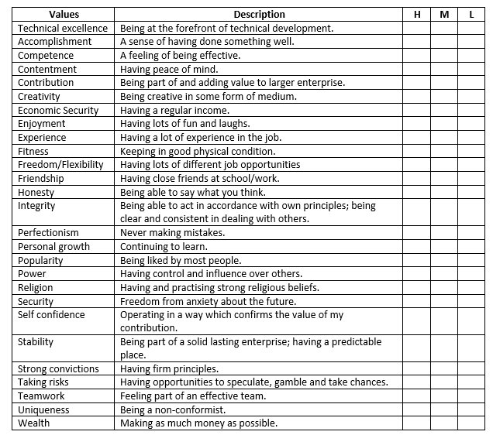
What are your personal values?
1. For each value identify the ‘level of importance that value holds for you: H = high level of importance M = medium level of importance L = Low level of importance
2. Pick your top three HIGH importance values.
3. Now from those top 3, choose you number 1 HIGHEST important value.
4. Discuss your choice with a friend or family member.

Slide 3
We all live in Britain, what do you think British values are?

Slide 4
Our Government identifies the following as our Fundamental British Values.
Why does the government feel it is important to promote a set of shared values for British citizens?
Democracy
The rule of law
Individual liberty
Mutual respect
Tolerance of those of different faiths and beliefs

Slide 5
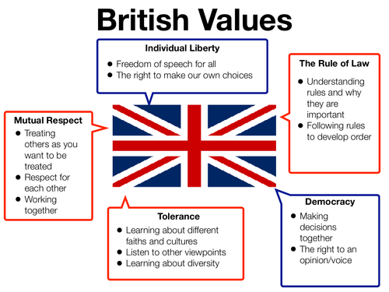
In Britain, as long as we do not break the law, we can live as we choose to and have our own opinions about things.
In Britain we have a police force who make sure people do not do the wrong thing and break the law – this means that we are safe.
Can you name political parties in Britain today?
Do you know what their core values are?
Have you considered who you might vote for in a general election?
What do you feel about Brexit?
Understanding the value of diversity and challenging discrimination. We might not always agree with other people, but we try to show respect for their thoughts and feelings.
The people in Britain vote for the people who make the laws and decide how the country is run.
If just one person made all the laws it would not be fair.
In the 2011 Census, Christianity was the largest religion, with 59.3% of the population. The second largest religious group were Muslims with 4.8% of the population.
Around a quarter of the population in England and Wales, reported they have no religion in 2011. 7.2% of people did not answer the question.
Prejudice: making judgements about people without knowing anything about them. Discrimination: The actions of treating people differently based on prejudices Why do you think people judge others before knowing them?
In Britain we accept that other people might have different beliefs and religions than ours. We should not discriminate or segregate those who we see as different to ourselves.

Slide 6
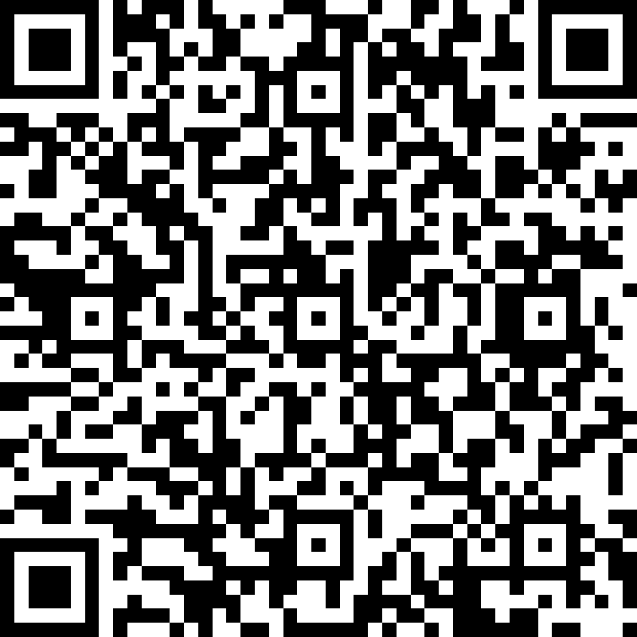
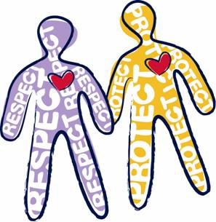
Debating British Values
Democracy
The Rule of Law
Individual Liberty
Mutual Respect
Tolerance of those with different faiths and beliefs
TASK: Complete the quick questions on Microsoft forms at this link:
https://forms.office.com/Pages/ResponsePage.aspx?id=onNUZMViq0uKbYN8DZZYfOEncZM8HFdIog1NJDUgEq1UMUc2SjFCQ0tTM1RPT1JHWFQyMUNYSTNNMS4u

