Slide 1

A Level Physics Course Guide (Year 12)

Slide 2
Student/Teacher agreement.
Welcome to A-Level Physics,
To be a successful A-Level Physics candidate we expect the following from our students:
To attend all lessons where possible and maintain 96% or above attendance.
To complete in-class work to a reasonable standard and maintain your own well-kept notes
To complete all core practicals, catching up on those that are missed
To complete homework set by class teachers where applicable
To take responsibility for your own work and its presentation, including your folder(s).
To complete the post-lesson tasks for each teacher’s lesson in a timely manner.
Consent to regular folder checks to ensure expectations are being met
In return you can expect the following:
Excellent support with your studies throughout your time at sixth form
Excellent subject knowledge and an informed perspective of how to develop STEM Learning beyond Sixth Form
Help with University/Job/Placement applications
Regular verbal and written feedback from all teachers, including assessed work marked within 2 weeks of the hand-in deadline
Ready availability of your teachers via e-mail or in-person

Slide 3
Course Information
We do to AQA Exam Board for A-Level Physics. A course specification will be given to all students separately but is readily available online on the AQA Website. A direct URL is: https://filestore.aqa.org.uk/resources/physics/specifications/AQA-7407-7408-SP-2015.PDF
You will be assessed summatively with three exams during the new assessment weeks. You will also complete checkpoint assessments in class at the end of each topic. We do the Astrophysics (7A) Option at A2.
Teaching staff
You will have 2 teachers throughout Year 12. Each teacher will have 5 lessons per fortnight with you. We are:
Miss Sales, head of physics, room D3.4
Mr Green-Pride, physics teacher, D3.3
Mrs O’Regan-Harding, physics teacher, D3.2
Any issues or concerns that you are having with regards to the course or subject should in the first instance be referred to Miss Sales via the Arthur Terry enquiry email.

Slide 4
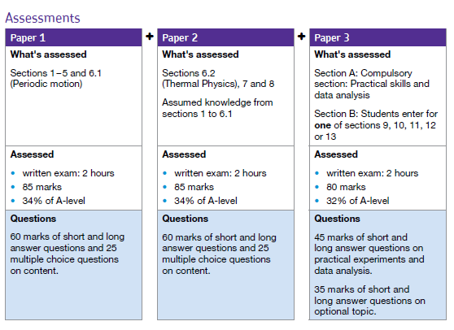
Course Information
At the end of year 13 there are 3 papers in the following set up.
Assessments throughout Year 12 will be conducted to ensure that you will be able to cope with the higher demand of the second year of the course. These exams are also used as a basis for the grades we use in UCAS applications (or similar).

Slide 5
Practical Competency Award
Alongside the course content, you will complete 12 required practicals, the practicals are examined as you do them by your class teacher and make up your Practical competency qualification. You will write up each practical and your write up will also be assessed and go towards you core practical qualification (CPAC). These must be completed and universities often have a CPAC pass as a condition of entry into STEM-based courses. The skills learned during the core practical's will also be examined as part of Paper 2.
The 12 required practical's are shown below. You will complete practical's 1-6 in Year 12.
1 | Investigation into the variation of the frequency of stationary waves on a string with length, tension, and mass per unit length of the string.
2 | Investigation of interference effects to include the Young’s slit experiment and interference by a diffraction grating.
3 | Determination of g by a free-fall method
4 | Determination of the Young’s Modulus by a simple method
5 | Determination of the resistvity of a wire using a micrometer, ammeter, and voltmeter.
6 | Investigation of the emf and internal resistance of electric cells and batteries by measuring the variation of the terminal p.d. of the cell with the current in it.
7 | Investigation into the simple harmonic motion using a mass-spring system and a simple pendulum.
8 | Investigation into Boyle’s and Charles’ Law for a gas
9 | Investigation of the charge and discharge of capacitors. Analysis techniques should include log-linear plotting leading to a determination of the time constant RC.
10 | Investigate how the force on a wire varies with flux density, current, and length of wire using a top-pan balance.
11 | Investigate, using a search coil and oscilloscope, the effect on magnetic flux linkage of varying the angle between a search coil and magnetic field direction.
12 | Investigation of the inverse-square law for gamma radiation.

Slide 6
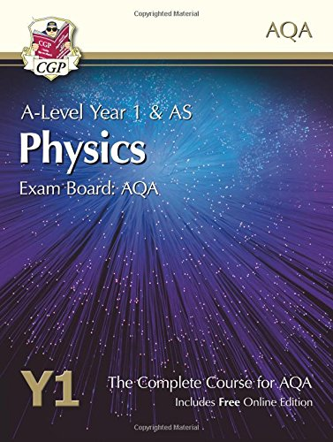
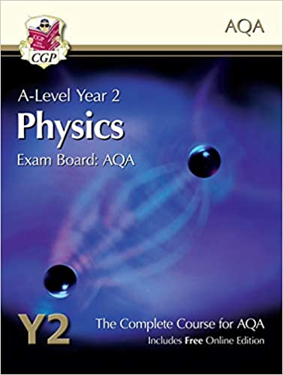
Textbooks
We recommend buying a textbook or revision guide to help you through the course. You can find different options here
recommended books
If you have any questions when it comes to ordering these please email us.
The textbooks recommended are:
CGP AS / Year 1 Physics – The Complete Course for AQA
(for Year 12)
AND
CGP A-Level Year 2 Physics – The Complete Course for AQA
(for Year 13)

Slide 7
A level File Expectations
Your folders will be checked every half term.
The list below outlines the expectations for your file:
Folder divided into topics
Printed module notes booklets have tasks completed up to date. (provided)
Neatly written up notes which are filed in the correct place.
Checkpoints kept at the end of relevant topic.
Evidence of independent learning and completion of gap tasks/homeworks.
Practical books.
All practical work that is required as part of the qualification will be completed in a PAG book. This book is only for required practical's and not for practical's done to enhance learning.
These books stay in school. It is expected that you follow a high standard and each practical is completed in full.

Slide 8
Overview of Year 12

Slide 9
Overview of Year 12

