Slide 1
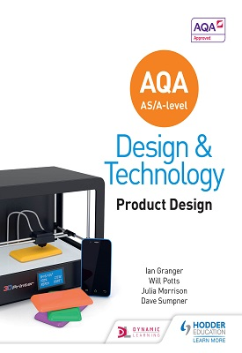
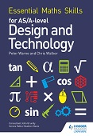
D&T A Level AQA Product Design
Year 11 to A Level Bridging Work
Administration
Set yourself up well for success. Before you arrive to A level D&T in September, you need to complete the following tasks...
Print off the specification (7552) and familiarise yourself with the topics and content you will need to know by the end of this course. (Pages 9-46) You will find the spec on the link below. https://www.aqa.org.uk/subjects/design-and-technology/as-and-a-level/design-and-technology-productdesign-7552
Buy a full pencil case of equipment and a scientific calculator.
Buy the A Level AQA Design and Technology course book that you will need to study from for this A Level. In addition to the course book the Maths in Design and Technology book is also useful, especially if you are not confident with your maths. Book details and ISBN numbers found below: Publisher: Hodder ISBN-13: 9781510414082. Essential Maths: Authors: Peter Warne and Chris Walker Publisher: Philip Allan ISBN-13: 978-1510417069 Computer Aided Design:

Slide 2
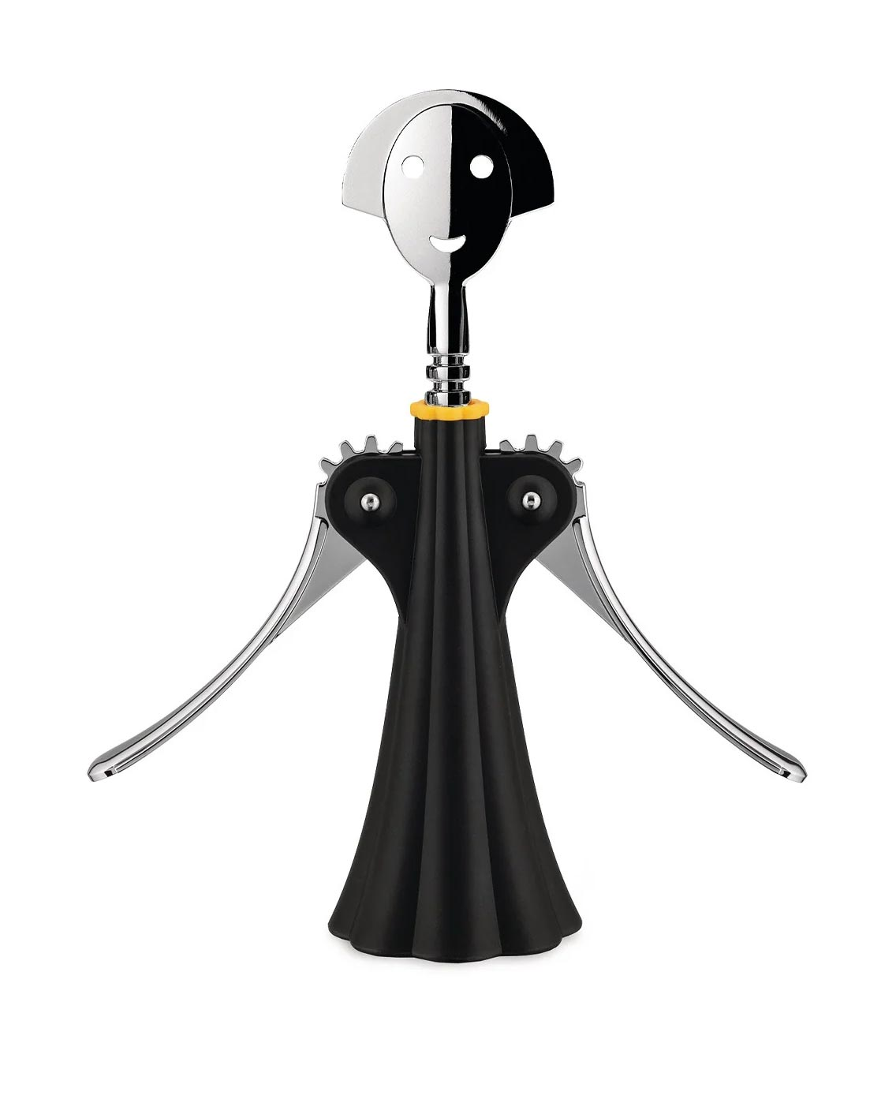

Trademarks, Logos and Branding in Product Design
Logos and trademarks are key to product identity, recognition and protecting intellectual property.
Complete the following:
Research and define the following terms (in your own words):
  Trademark
  Logo
  Brand Identity
  Copyright
  Patent
Find 3 well-known logos (e.g., Apple, Nike, LEGO):
  Paste or draw them.
  Briefly explain what makes each logo effective (e.g., simplicity, colour, symbolism, memorability).
  Identify whether the logo might be trademarked and why that matters.
Design your own logo for a fictional product or brand (e.g., a tech gadget, sustainable fashion line, snack brand).
  Sketch the logo.
  Underneath, write a short paragraph (100 words max) describing:
    The meaning behind your design
    The colours/fonts used
    Where and how you would apply for trademark protection
Anthropometrics and Anthropomorphism
Anthropometrics
Research what anthropometrics is and how it’s used in product design.
Answer these questions:
What is anthropometrics?
Why is it important in designing everyday products (e.g., chairs, phones, kitchen tools)?
Choose 2 everyday products and explain how anthropometric data might influence their design.
Anthropomorphism
Find out what anthropomorphism means in design.
Answer:
What is anthropomorphism?
Give an example of a product that shows human characteristics and explain how this can improve user experience.

Slide 3
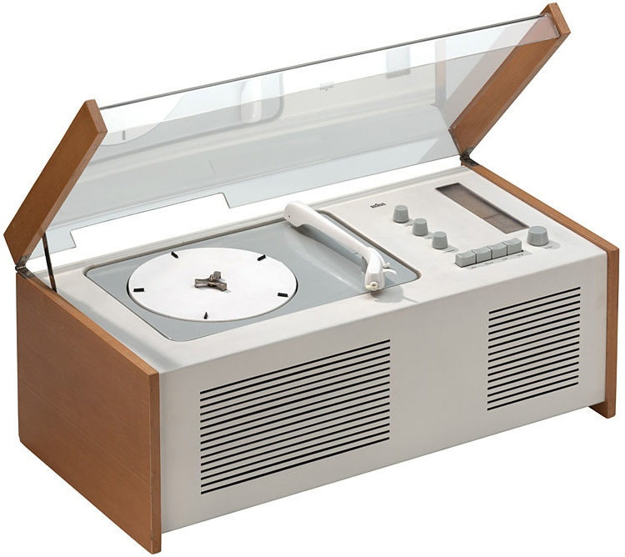

Product Suitability – the shopping basket
Shopping baskets are everyday products, but good design is essential for their function, durability, and user experience. In this task, you'll evaluate how suitable the design of a shopping basket is for its intended purpose.
Part A: Product Analysis (Written – around 150 words)
Take a photo or sketch a shopping basket. Observe how customers interact with it.
Evaluate the product’s suitability for its purpose by answering the following:
  What materials is it made from, and why?
  How well does it meet the needs of different users (e.g., elderly, children, people with disabilities)?
  Is the shape and size practical for carrying items?
  Are there any ergonomic considerations in the handle design?
  How durable and sustainable is it?
Designer Study – Dieter Rams
Who is Dieter Rams and why is he so influential in design?
Use the internet and books to research the German industrial designer Dieter Rams. Focus especially on his "10 Principles of Good Design."
Complete the following:
Create a short profile (around 200 words) about Rams.
Choose 3 of his most iconic products. Include an image of each and explain how they reflect his design principles.
Pick your favourite principle from the "10 Principles" and explain why it’s relevant today.

